Slide 1
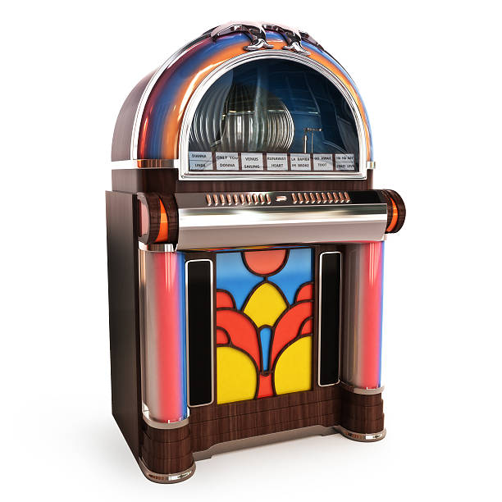
THE JUKEBOX
JAVA Project
Presented by Apoorv Goliyan

Slide 2

Introduction
A jukebox is a partially automated music-playing device, usually a coin-operated machine, that will play a patron's selection from self-contained media. The classic jukebox has buttons, with letters and numbers on them, which are used to select a specific record. Some may use compact discs instead.
Music jukeboxes were commonly used in restaurants ands bars
To enable customers to choose what music they wanted to listen.
Electronic and digital jukeboxes became prevalent from 70’s and 80’s. Modern
Jukeboxes are fully computerized and play stream music from the internet directly.

Slide 3
Problem Domain
In existing system the user can’t search the song/ podcast by particular category.
User can’t create a combination of song and podcast playlist.
It is not possible for user to add a song /podcast to already created playlist.

Slide 4
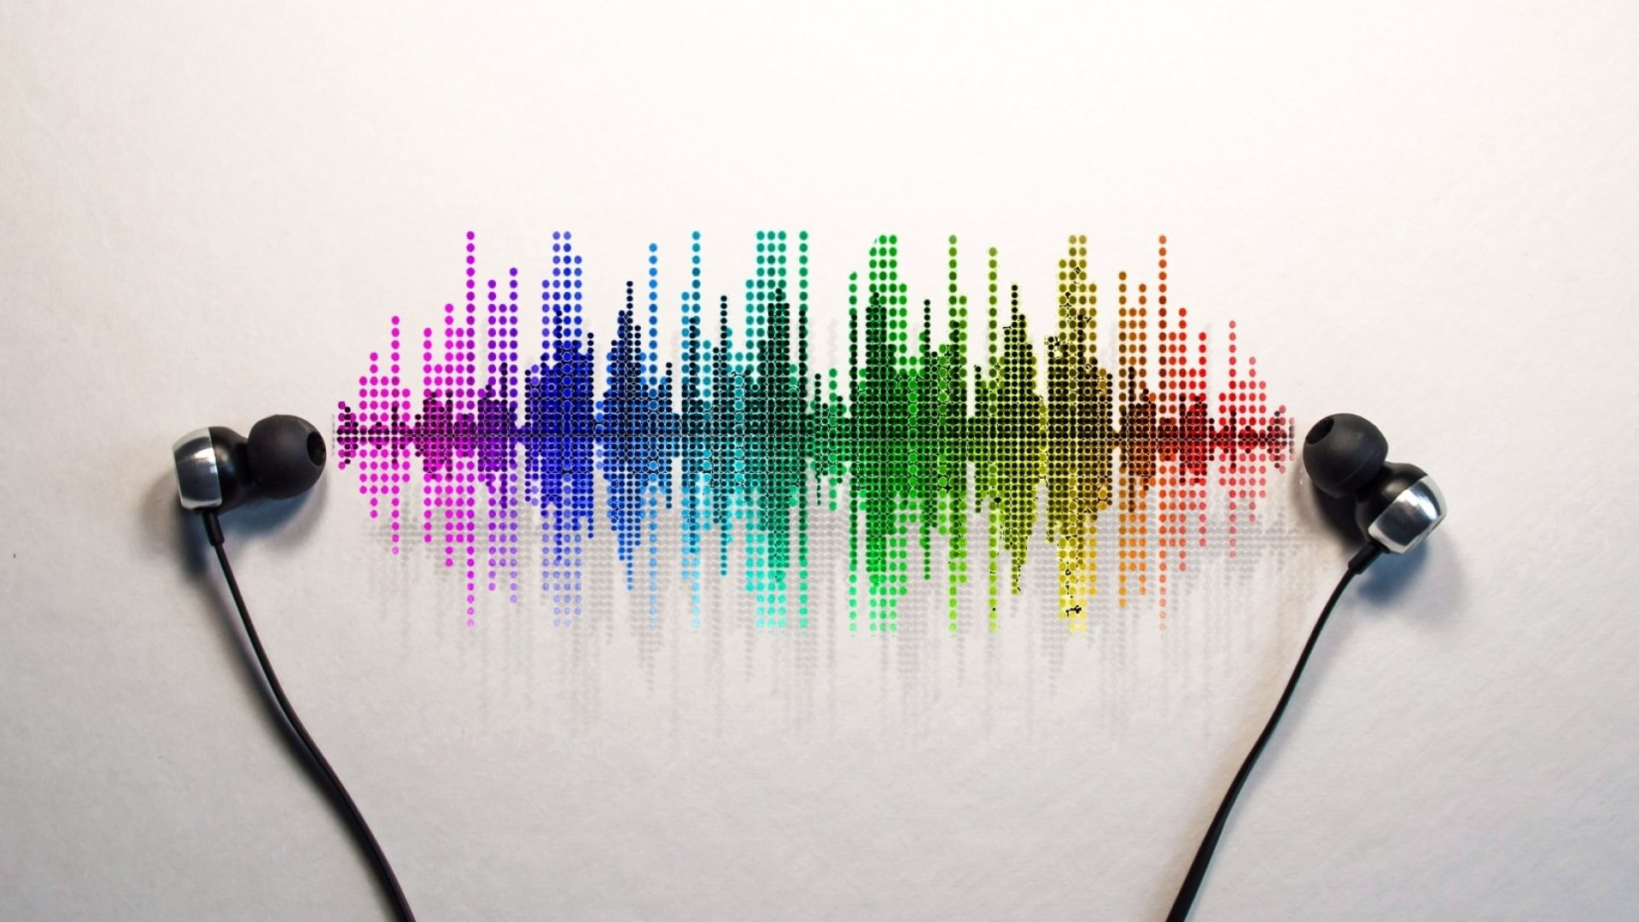
Application Supported
USER SIGNUP,LOGIN
DISPLAY ALL SONG
DISPLAY ALL PODCAST
SEARCHING A SONG
SORTING A SONG
SEARCHING A PODCAST
SORTING A PODCAST
ON DEMAND MUSIC,PODCAST LISTENING

Slide 5
Data Management
USER CLASS
SONGS CLASS
PODCAST CLASS
AUDIO CLASS
PLAYLIST CLASS

Slide 6
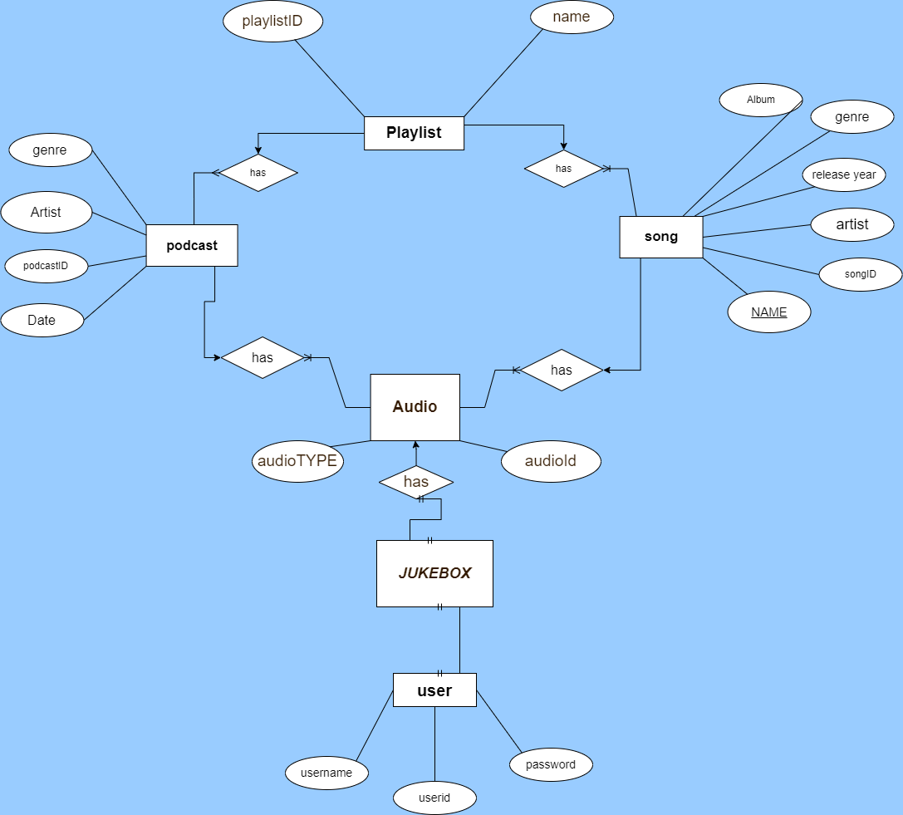
ER Diagram

Slide 7
Tables Description
USERS:- ( USERID, USERNAME , USERPASS)
SONGS:- (SONGID,SONGNAME,ARTISTNAME,ALBUMNAME,YEAR,GENRE,URL)
PODCAST:- (PODCASTID,PODCASTNAME,RELEASEDATE,GENRE,CELIBIRITY,URL)
PLAYLIST:- (PLAYLISTID,PLAYLISTNAME,USERID,AUDIOID)
AUDIO:- (AUDIOID,SONGID,PODCASTID,AUDIOTYPE)

Slide 8
THANK YOU
.
** Let See output on IntelliJ

